Slide 1
Ad Hoc Networks
Lecture WK 4A - CS 117Winter 2013
Mario Gerla
Computer Science Dept
UCLA

Slide 2
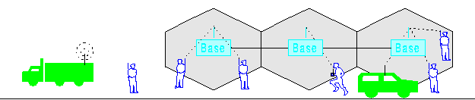
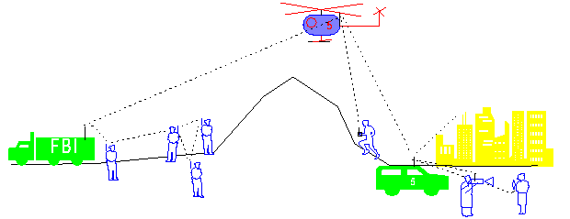
Infrastructure vs Ad Hoc
Infrastructure Network (cellular or Hot spot)
Ad Hoc, Multihop wireless Network

Slide 3
General Ad Hoc Network Characteristics
Instantly deployable (no fixed infrastructure)
Satisfies a “temporary” need
Node mobility, relocation
Limited battery power
Multi-hopping ( to save power, overcome obstacles, enhance spatial spectrum reuse, etc.)

Slide 4
Ad Hoc Network Applications
Military
  Automated battlefield
Civilian
  Disaster Recovery (flood, fire, earthquakes etc)
  Law enforcement (crowd control)
  Search and rescue in remote areas
  Environment monitoring (sensors)
  Space/planet exploration
Commercial
  Vehicular communications
  Wireless health networking

Slide 5
Ad Hoc network implementations
Ad hoc nets can be implemented with different radio and MAC technologies:
Most common is 802.11 “ad hoc mode”
Bluetooth scatternets
Zigbee 802.15.4 trees and meshes
Even UWB (Ultra Wide Band) radios…

Slide 6
Notes:
The figure illustrates a battlefield scenario in which there are several agent teams.
These agent teams may appear to be localized in different sectors with different tasks, they are actually interlocking components commanded by mission control located offshore on a manned control platform.
The anticipated UCAV missions are close air support, surveillance, reconnaissance, and strike.
The principal objective of the vehicles is to enable time-critical over-the-horizon target detection, identification, tracking, and precision engagement where targets could be stationary or mobile and often in clutter environment.

Slide 7
What are the new problems in ad hoc networks?
In the study of wireless technologies so far, we have addressed:
  Radio channel problems
  MAC protocols
Now, with ad hoc nets, need to address:
  Routing, multicast
  Topology reconfiguration in mobile environments
  TCP over multihop nets
  Streaming over multihop nets
  Location, position determination
  Peer to Peer networking over ad hoc

Slide 8

Distance Vector scheme (Internet)
0
Routing table at node 5 :
1
3
2
Tables grow linearly with # nodes
Control O/H grows with
mobility and size
4
5

Slide 9
On-Demand Routing
On demand routing unique of ad hoc nets
Routes are established “on demand” as requested by the source
Only the active routes are maintained by each node
Two leading methods for route discovery: source routing and backward learning (similar to LAN interconnection routing)

Slide 10
On Demand Routing - Optional Readings
D. B. Johnson and D. A. Maltz, "Dynamic Source Routing in Ad-Hoc Wireless
Networks," Mobile Computing, 1994.
Charles E. Perkins and Elizabeth M. Royer. "Ad hoc On-Demand Distance Vector
Routing." Proceedings of the 2nd IEEE Workshop on Mobile Computing Systems
and Applications, New Orleans, LA, February 1999, pp. 90-100.

Slide 11
Dynamic Source Routing (DSR)
Forwarding: source route driven instead of hop-by-hop route table driven
No periodic routing update message is sent
The first path discovered is selected as the route
Next we describe:
  Route Discovery

Slide 12
DSR - Route Discovery
To establish a route, the source floods a Route Request message
The Route Request packet “picks up” the intermediate node ID numbers
Route Reply message containing path information is sent back to the source either by
  the destination, or
  intermediate nodes that have a route to the destination

Slide 13
Route Discovery
Source broadcasts Route Request (RREQ)
Node can reply to RREQ if
  It is the destination, or
  It has a “fresh enough” route to the destination
Otherwise it rebroadcasts the request
Packet Forwarding: source route driven instead of hop-by-hop route table driven
Source
Destination
Route Request Propagation

Slide 14
Dynamic Source Routing (DSR)
Forwarding: source route driven instead of hop-by-hop route table driven
No periodic routing update message is sent
The first path discovered is selected as the route
Two main phases
  Route Discovery
  Route Maintenance

Slide 15
DSR - Route Maintenance
Route maintenance performed only while route is in use
Monitors the validity of existing routes by passively listening to acknowledgments of data packets transmitted to neighboring nodes
When problem detected, send Route Error packet to original sender to perform new route discovery

Slide 16
Ad Hoc net commercial applications?
Most of the on-going mobile ad hoc network research is aimed at:
  Military, large scale applications
  Civilian application (disaster recovery, homeland defense, planetary exploration, etc)
  Large sensor deployments
Is the “military” technology ready to transfer to commodity applications?
Where are the commercial applications?

Slide 17
Vision: Opportunistic Ad Hoc Networking
Commodity ad hoc networks will not “happen” as isolated, self configured nets (as in the “military” model)
Rather, they will emerge as a “no cost” extension of the “infrastructure”
Examples of Ad Hoc extensions (of Wireless Internet)
  Indoor W-LAN extended coverage
  Hot spot (Mesh Networks) extensions
  Group of friends sharing 3G access via Bluetooth
  Peer 2 peer networking in the urban vehicle grid

Slide 18

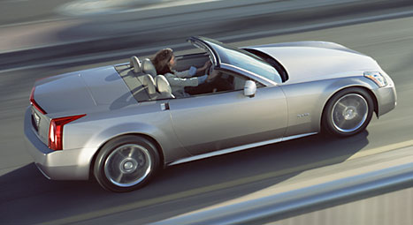
Urban Ad Hoc net in action: Safe Driving
Vehicle type: Cadillac XLR
Curb weight: 3,547 lbs
Speed: 65 mph
Acceleration: - 5m/sec^2
Coefficient of friction: .65
Driver Attention: Yes
Etc.
Vehicle type: Cadillac XLR
Curb weight: 3,547 lbs
Speed: 75 mph
Acceleration: + 20m/sec^2
Coefficient of friction: .65
Driver Attention: Yes
Etc.
Alert Status: None
Alert Status: None
Alert Status: Inattentive Driver on Right
Alert Status: Slowing vehicle ahead
Alert Status: Passing vehicle on left
Vehicle type: Cadillac XLR
Curb weight: 3,547 lbs
Speed: 45 mph
Acceleration: - 20m/sec^2
Coefficient of friction: .65
Driver Attention: No
Etc.
Vehicle type: Cadillac XLR
Curb weight: 3,547 lbs
Speed: 75 mph
Acceleration: + 10m/sec^2
Coefficient of friction: .65
Driver Attention: Yes
Etc.
Alert Status: Passing Vehicle on left

Slide 19
CarTorrent : Car to car downloading of multimedia files

Slide 20

You are driving to Vegas
You hear of this new show on the radio
Video preview on the web (10MB)
Notes:
Video clip to download after seeing a billborad on the way to Vegas…

Slide 21





Highway Infostation download
Internet
file

Slide 22
Problem: Stopping at gas station to download is a nuisance
Observation: many other drivers are downloading the same files (like in the Internet)
Solution: Co-operative P2P Downloading using the Car to Car ad hoc nets (Car-Torrent)

Slide 23
Partial download from Infostation
Internet
Download

Slide 24
Co-operative P2P Download
Internet
P2P Exchange of Pieces
Vehicle-Vehicle Communication

Slide 25
Car-Torrent: opportunistic incentives
Bandwidth at the infostation is limited and “not convenient”
  It can become congested if all vehicles stop
  It is a nuisance as I must stop and waste time
GPRS and 3G bandwidth is limited
The car to car bandwidth is unlimited and FREE!
Car to car ad hoc net already exists (safe navigation requirements)

